Slide 1

DBA5103
Operations Research and Analytics
Zhenyu Hu
Semester I, 2026/2027

Slide 2
Integer Programming
Integer Program Modeling
Further Applications
Linear Programming Relaxation
Branch and Bound Method

Slide 3
Integer Program Modeling

Slide 4
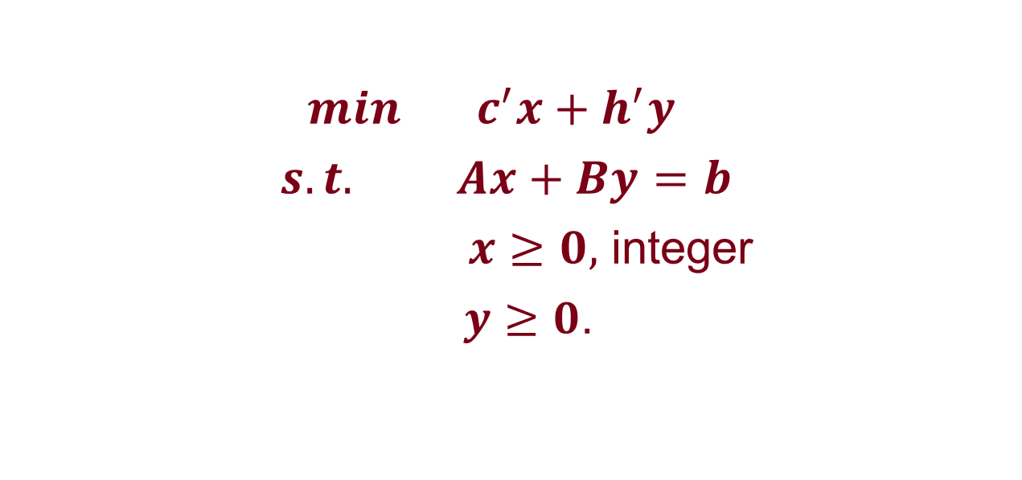
Mix IP
$min c^{′}x+h^{′}y$
$s.t. Ax+By=b$
$x≥0,$ integer
$y≥0$.

Slide 5
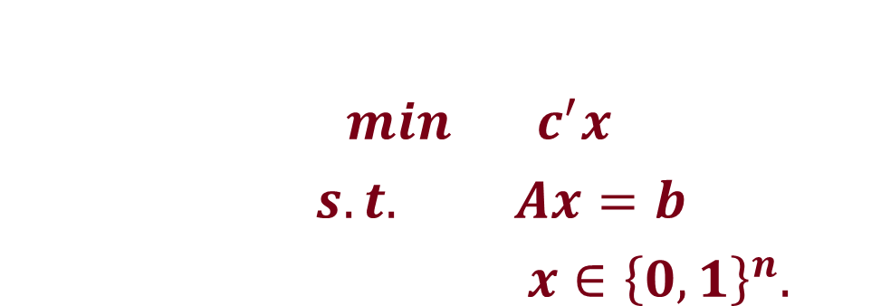

Pure IP
$min c^{′}x$
$s.t. Ax=b$
$x≥0,$ integer
IP
$min c^{′}x$
$s.t. Ax=b$
$x∈{\left\{0,1\right\}}^{n}.$
BIP

Slide 6

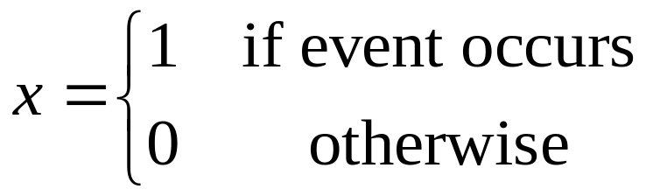
Modeling with Binary Variables

Slide 7
Choice Among Several Possibilities
Due to resource constraint, at most one of project 1,2, and 3 can be implemented. How to model this constraint?
If exactly two out of the five projects 2,3,4,5, and 6 must be implemented. How to model this constraint?

Slide 8
Simple Implications
If project 1 is chosen, then project 4 is also chosen.
If project 2 is chosen, then we cannot choose project 5.
If we don’t choose project 1, then project 6 must be chosen.
Project 4 and 5 belong to the same company. Either both of them are chosen or neither of them is chosen.

Slide 9
Implication with three variables
If we do project 2, then we must do project 3 and 4.
If we do project 3, then we must do project 1 or 5.
If we do both 3 and 4, then we must do 6.

Slide 10
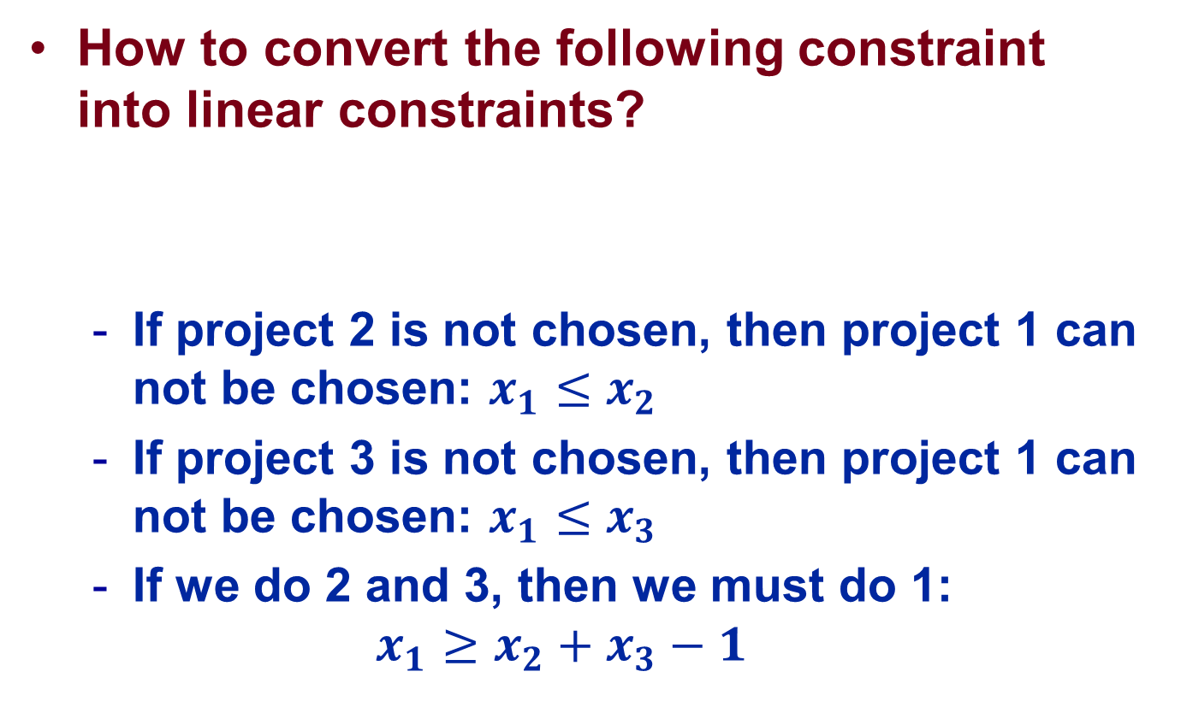

Product of Binary Variables
How to convert the following constraint
into linear constraints?
  If project 2 is not chosen, then project 1 can not be chosen: $x_{1}≤x_{2}$
  If project 3 is not chosen, then project 1 can not be chosen: $x_{1}≤x_{3}$
  If we do 2 and 3, then we must do 1:
  $$x_{1}≥x_{2}+x_{3}−1$$
$x_{1}=x_{2}{×x}_{3},{ x}_{1},x_{2}{,x}_{3}$ binary.

Slide 11
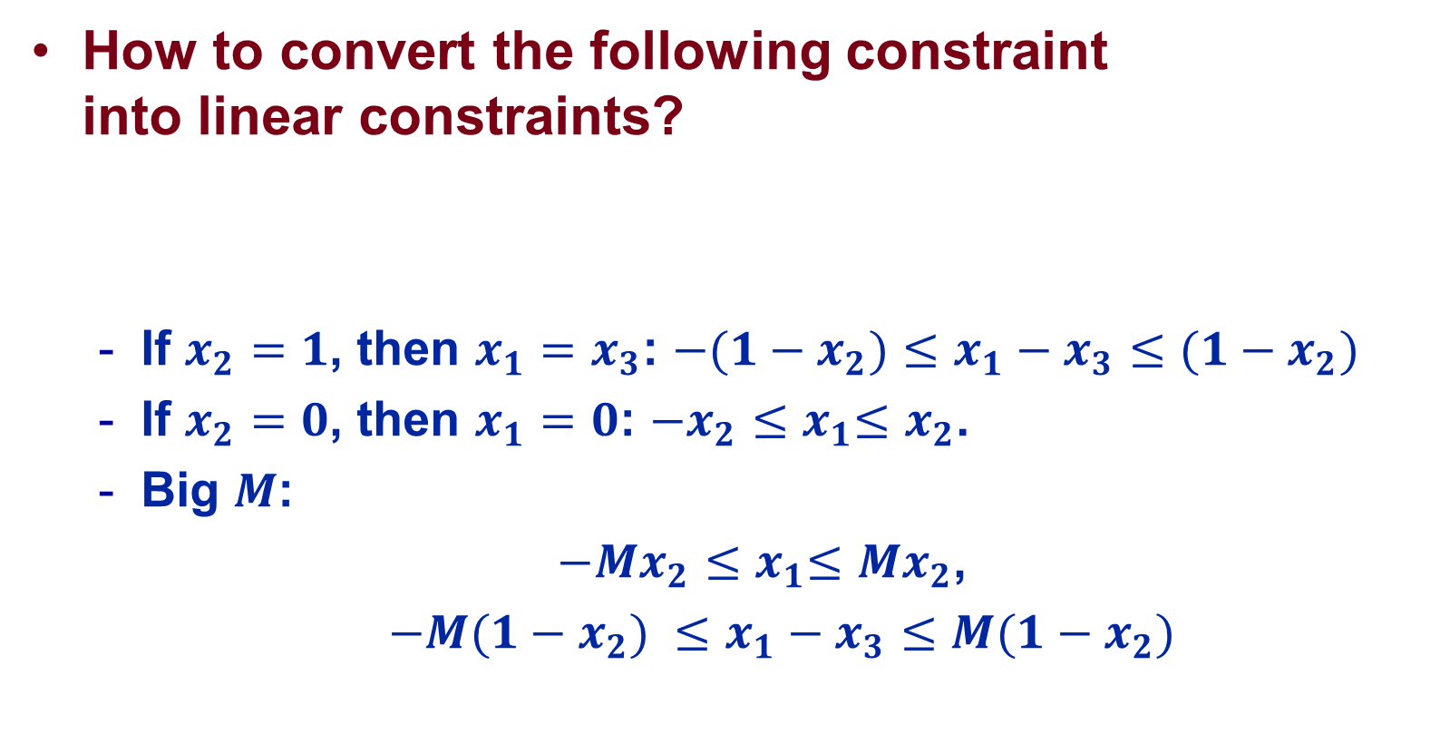

Product of Binary and Nonnegative Variables
How to convert the following constraint
into linear constraints?
  If $x_{2}=1$, then $x_{1}=x_{3}$: ${−(1−x_{2})≤x}_{1}−x_{3}≤(1−x_{2})$
  If $x_{2}=0$, then $x_{1}=0$: ${−x_{2}≤x}_{1}≤x_{2}$.
  Big $M$:
  ${−{Mx}_{2}≤x}_{1}≤{Mx}_{2}$,
  ${−M(1−x_{2}) ≤x}_{1}−x_{3}≤M(1−x_{2})$
$x_{1}=x_{2}{×x}_{3}, x_{2}$ binary.

Slide 12
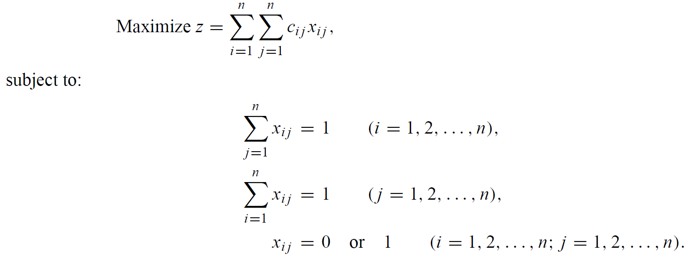
Assignment Problem

Slide 13
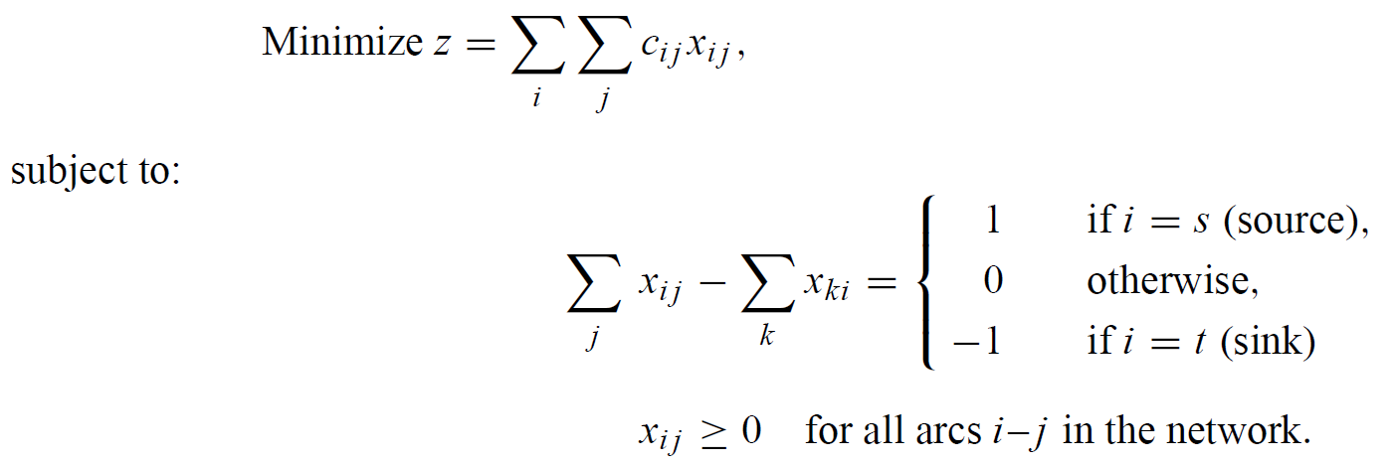
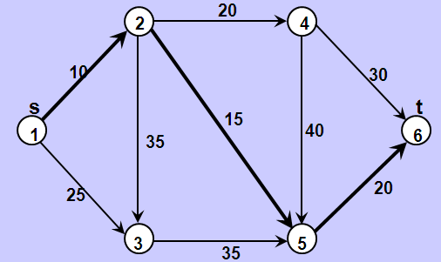

Shortest Path Problem

Slide 14
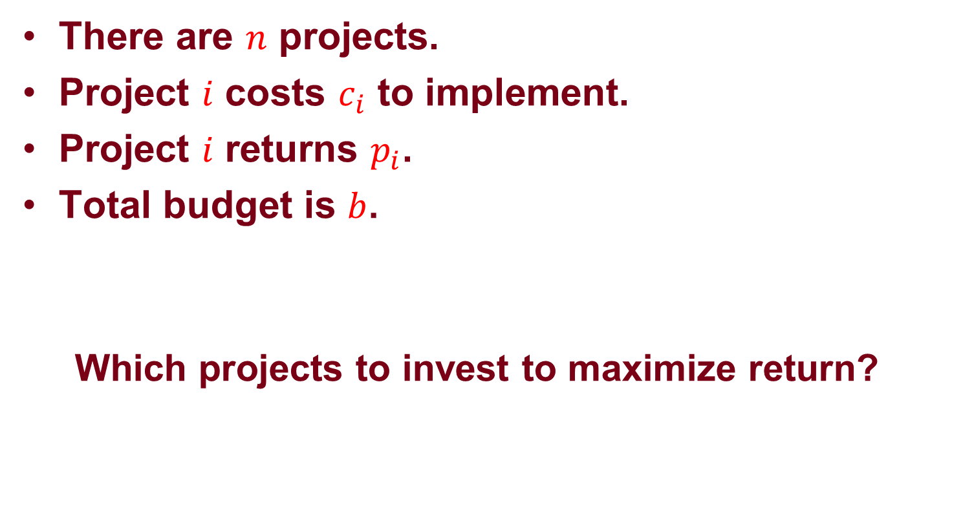
Knapsack Problem
There are $n$ projects.
Project $i$ costs $c_{i}$ to implement.
Project $i$ returns $p_{i}$.
Total budget is $b$.
Which projects to invest to maximize return?

Slide 15

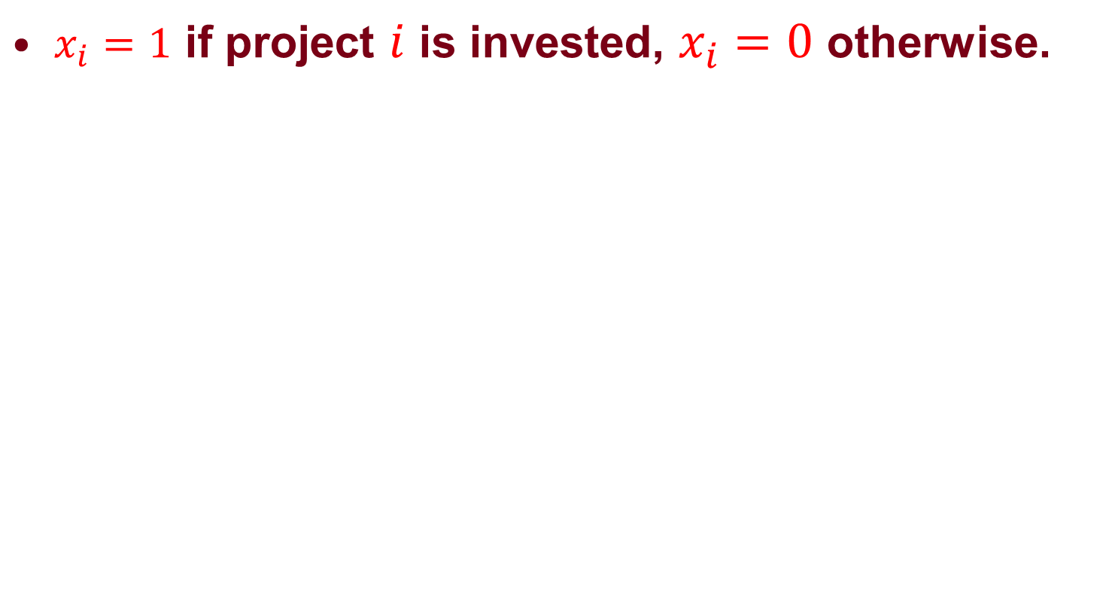
Knapsack Problem
$x_{i}=1$ if project $i$ is invested, $x_{i}=0$ otherwise.
Maximize: $\sum_{i=1}^{n}{p_{i}x_{i}}$
s.t. $\sum_{i=1}^{n}{c_{i}x_{i}}≤b$
$x_{i}$ binary

Slide 16
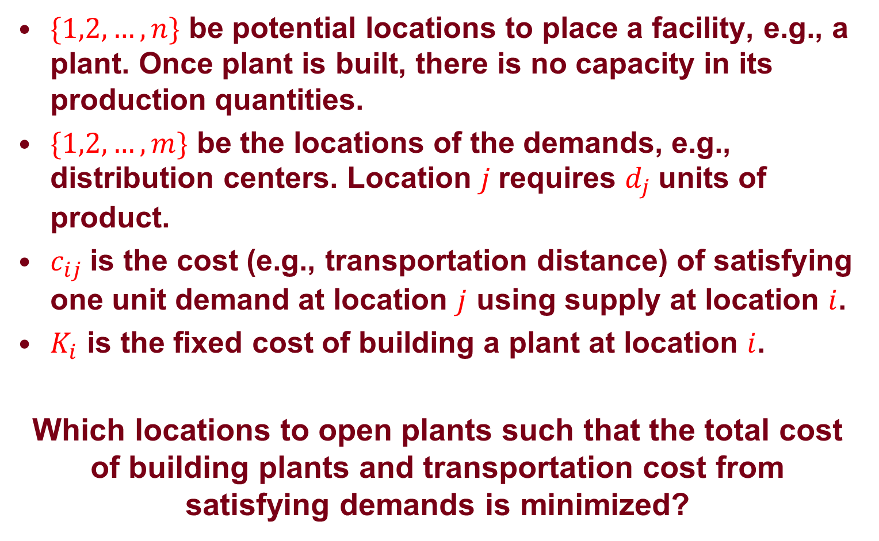
Facility Location Problem
$\{1,2,…,n\}$ be potential locations to place a facility, e.g., a plant. Once plant is built, there is no capacity in its production quantities.
$\{1,2,…,m\}$ be the locations of the demands, e.g., distribution centers. Location $j$ requires $d_{j}$ units of product.
$c_{ij}$is the cost (e.g., transportation distance) of satisfying one unit demand at location $j$ using supply at location $i$.
$K_{i}$ is the fixed cost of building a plant at location $i$.
Which locations to open plants such that the total cost of building plants and transportation cost from satisfying demands is minimized?

Slide 17
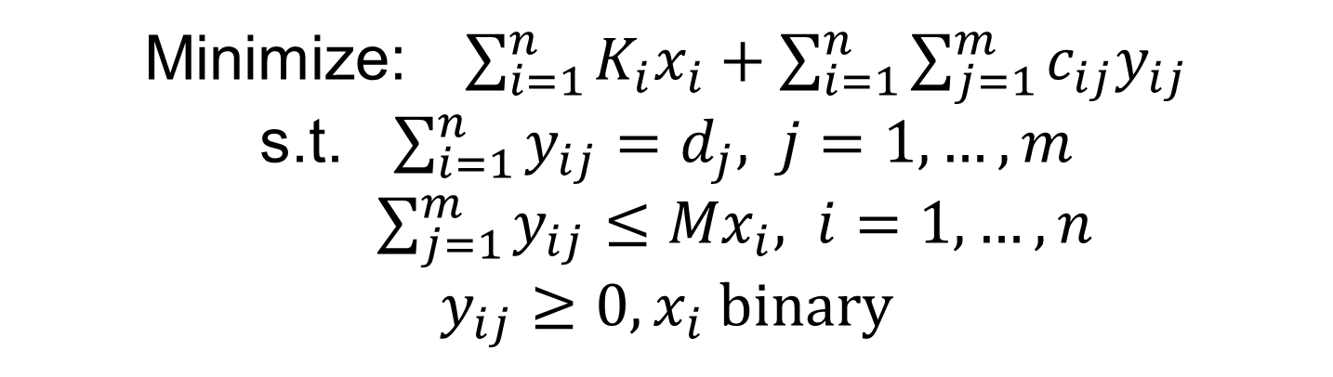
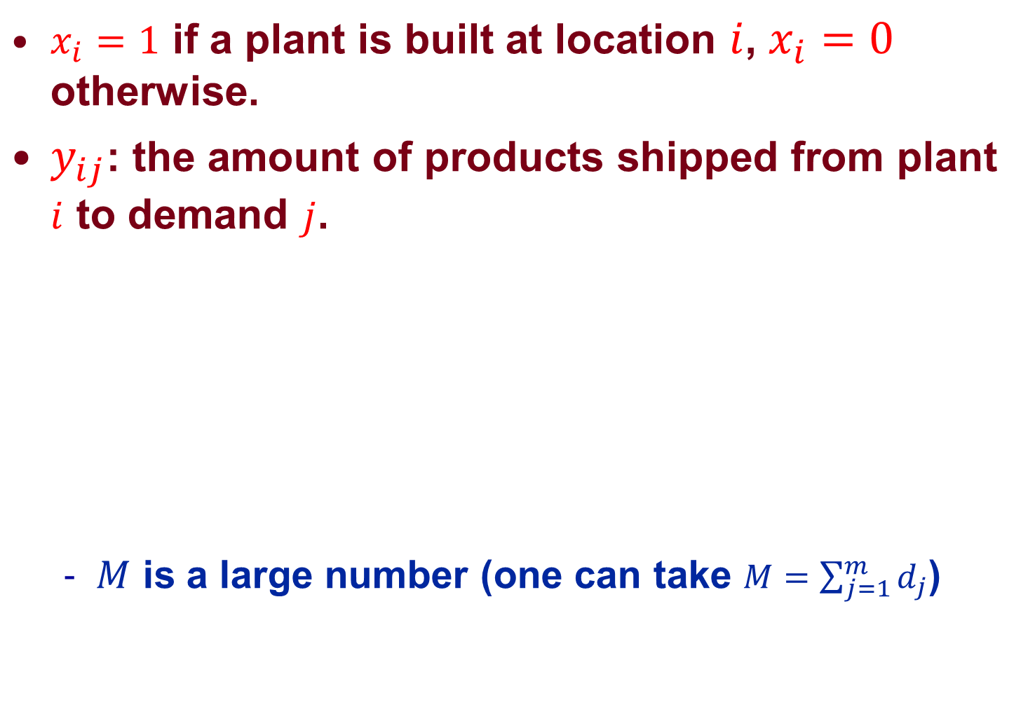
Facility Location Problem
$x_{i}=1$ if a plant is built at location $i$, $x_{i}=0$ otherwise.
$y_{ij}$: the amount of products shipped from plant $i$ to demand $j$.
  $M$ is a large number (one can take $M=\sum_{j=1}^{m}{d_{j}}$)
Minimize: $\sum_{i=1}^{n}{K_{i}x_{i}+\sum_{i=1}^{n}{\sum_{j=1}^{m}{c_{ij}y_{ij}}}}$
s.t. $\sum_{i=1}^{n}{y_{ij}}=d_{j}, j=1,…,m$
$\sum_{j=1}^{m}{y_{ij}}≤{Mx}_{i}, i=1,…,n$
${y_{ij}≥0, x}_{i}$ binary

Slide 18

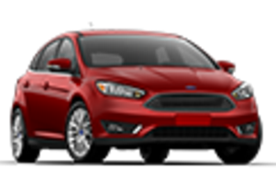
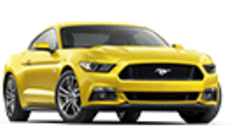
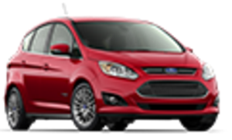
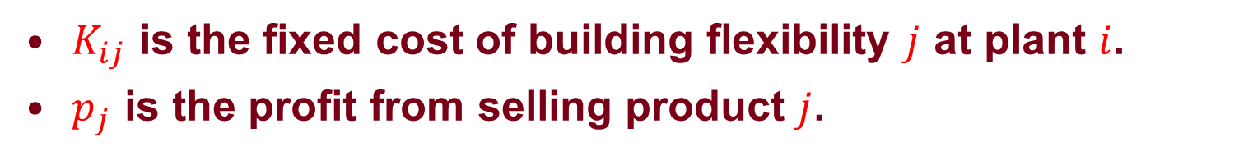





Process Flexibility
$K_{ij}$ is the fixed cost of building flexibility $j$ at plant $i$.
$p_{j}$ is the profit from selling product $j$.
$$K_{11}$$
100
20
$$K_{12}$$
$C_{i}$ = 100
$D_{j}$ = 140
$$K_{13}$$
100
140

Slide 19

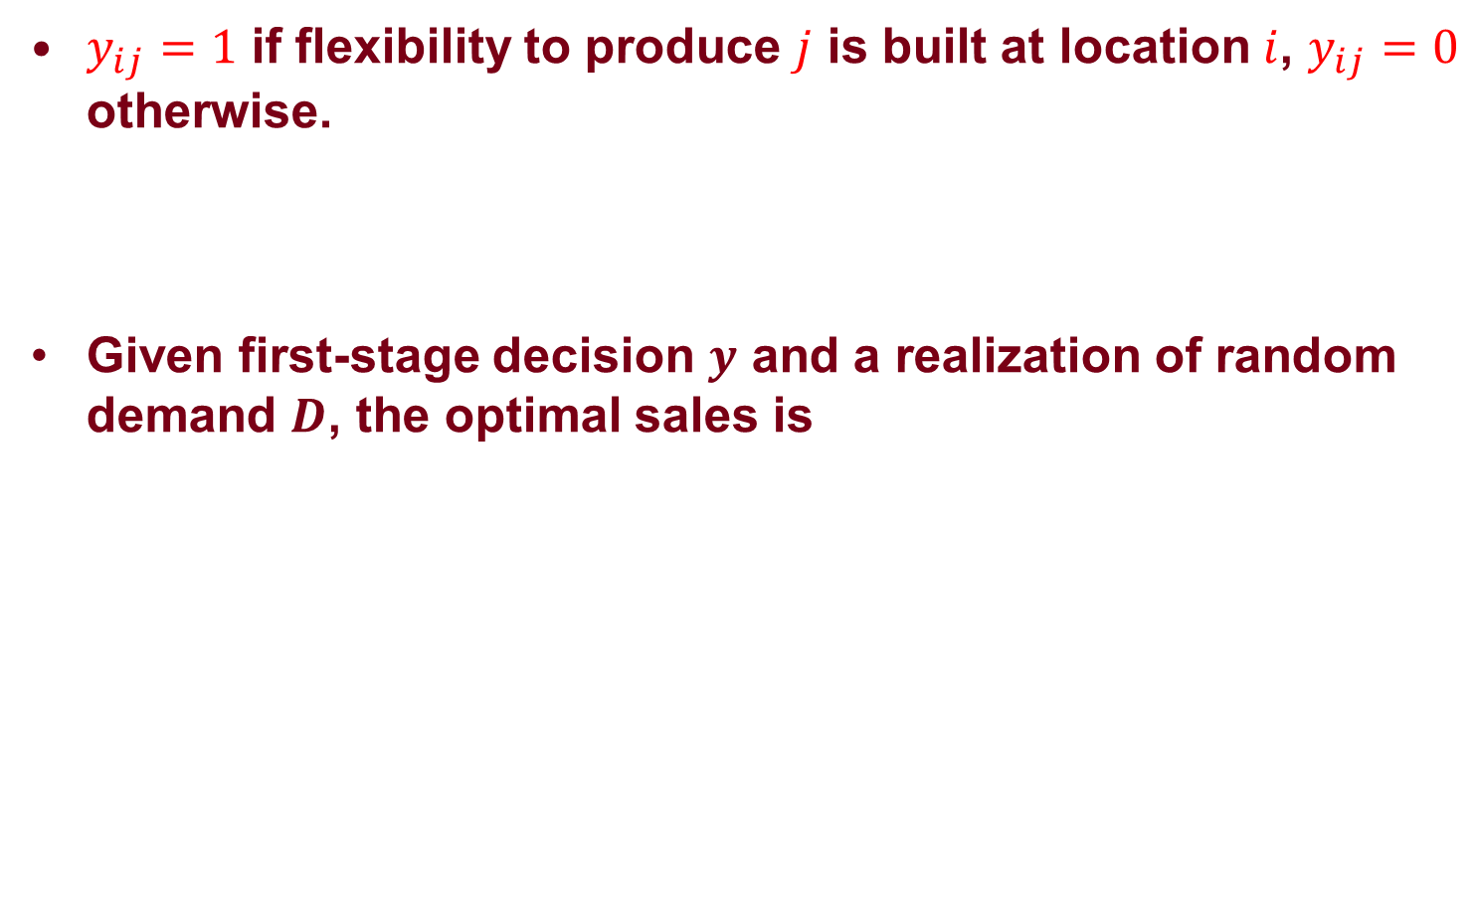
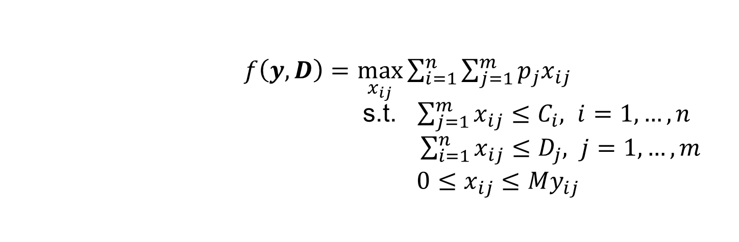
Two-Stage Stochastic Optimization
$y_{ij}=1$ if flexibility to produce $j$ is built at location $i$, $y_{ij}=0$ otherwise.
Given first-stage decision $y$ and a realization of random demand $D$, the optimal sales is
$$\max_{y_{ij}∈\{0,1\}}{−\sum_{i=1}^{n}{\sum_{j=1}^{m}{K_{ij}y_{ij}}+E[f(y,D)]}}$$
$f\left(y,D\right)=\max_{x_{ij}}{\sum_{i=1}^{n}{\sum_{j=1}^{m}{p_{j}x_{ij}}}}$
s.t. $\sum_{j=1}^{m}{x_{ij}}≤C_{i}, i=1,…,n$ $\sum_{i=1}^{n}{x_{ij}}≤D_{j}, j=1,…,m$
$0≤x_{ij}≤My_{ij}$

Slide 20

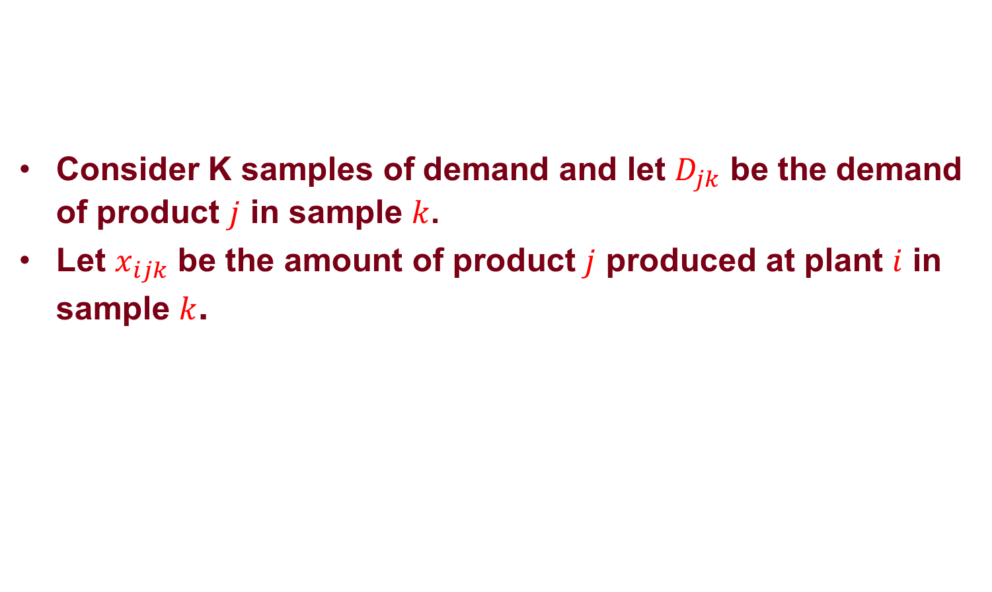
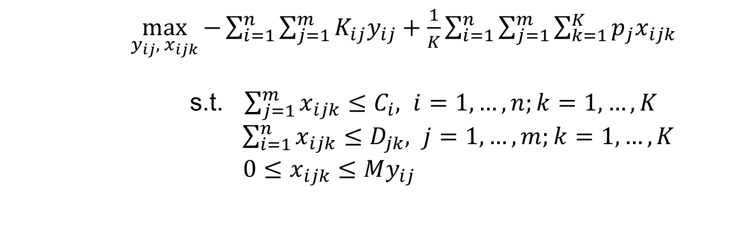
Sample Average Approximation
Consider K samples of demand and let $D_{jk}$ be the demand of product $j$ in sample $k$.
Let $x_{ijk}$ be the amount of product $j$ produced at plant $i$ in sample $k$.
$$\max_{y_{ij}∈\{0,1\}}{−\sum_{i=1}^{n}{\sum_{j=1}^{m}{K_{ij}y_{ij}}+E[f(y,D)]}}$$
$\max_{y_{ij}, { x}_{ijk}}{−\sum_{i=1}^{n}{\sum_{j=1}^{m}{K_{ij}y_{ij}}+\frac{1}{K}\sum_{i=1}^{n}{\sum_{j=1}^{m}{\sum_{k=1}^{K}{p_{j}x_{ijk}}}}}}$
s.t. $\sum_{j=1}^{m}{x_{ijk}}≤C_{i}, i=1,…,n;k=1,…,K$ $\sum_{i=1}^{n}{x_{ijk}}≤D_{jk}, j=1,…,m;k=1,…,K$
$0≤x_{ijk}≤My_{ij}$

Slide 21
Further Applications

Slide 22
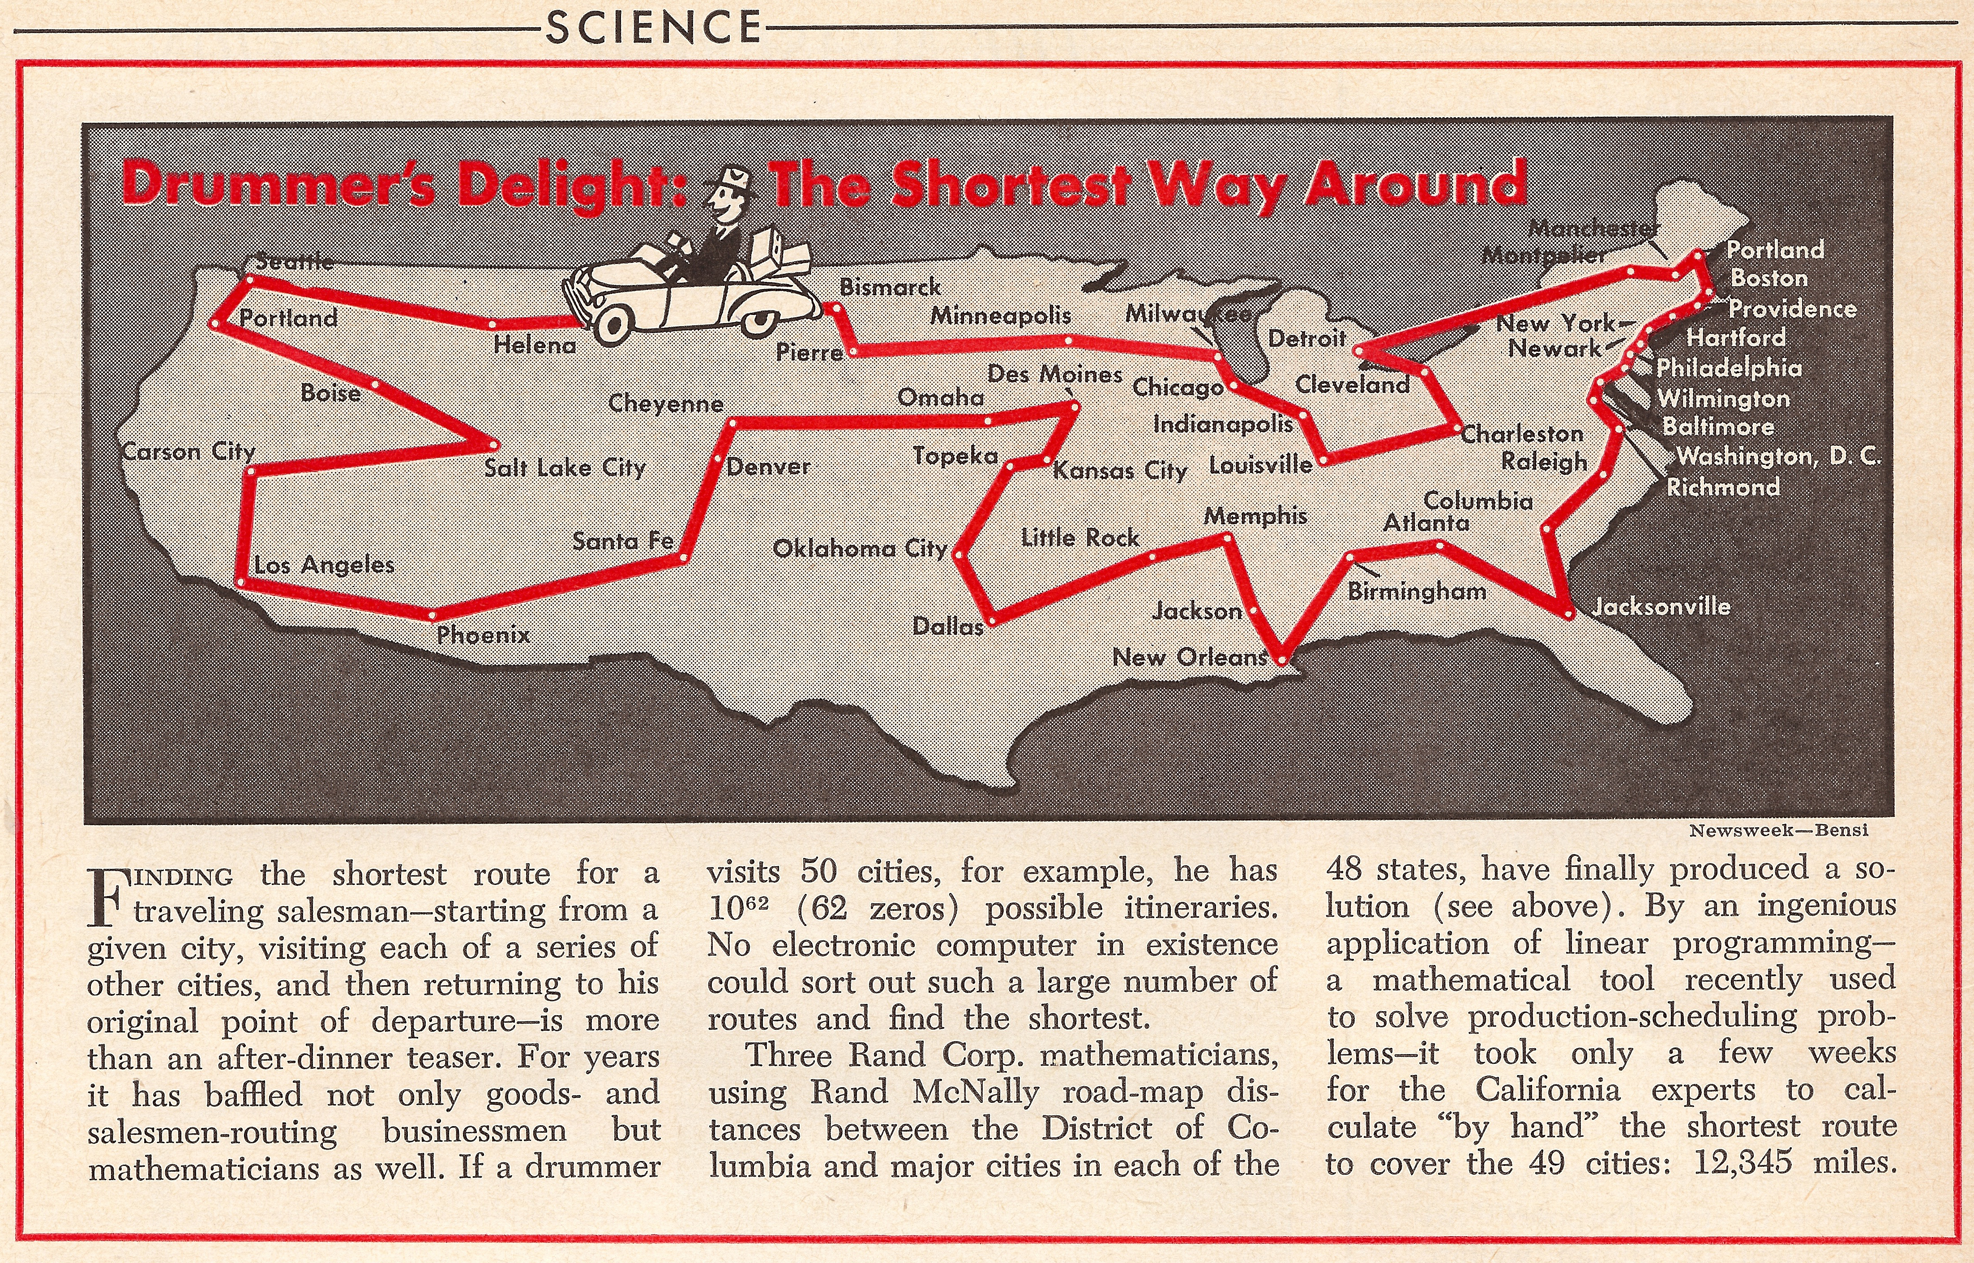
Travelling Salesman Problem
Given a list of cities and their pairwise distances, the task is to find a shortest possible tour that visits each city exactly once.
http://www.math.uwaterloo.ca/tsp/index.html

Slide 23
Complete Graph
Every pair of node is connected by an arc.
1
2
3
4
5

Slide 24
Mathematical Definition (Symmetric TSP)
Given a complete undirected graph and a cost on each arc, find a path starting and finishing at a specified node after having visited each other node exactly once (called Hamiltonian cycle) that minimizes the total cost.
If in application, no arc exists between two nodes, we can assign an arbitrarily large cost on the arc connecting these two nodes.

Slide 25
Naïve Method
Brute force enumeration.
How many feasible solutions are there?
How does $n!$ compare with $2^{n}$?

Slide 26
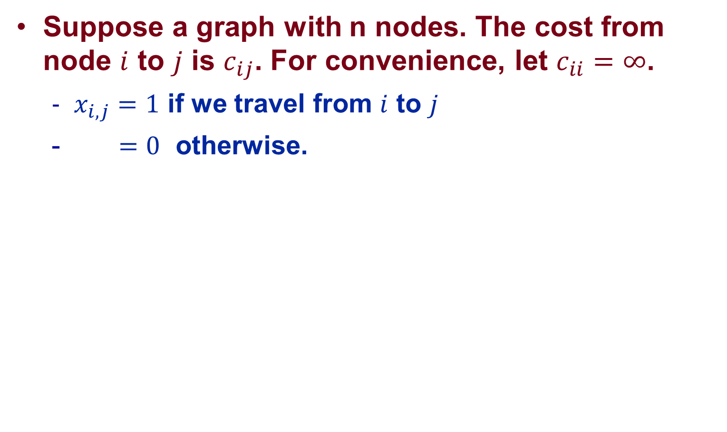
Model
Suppose a graph with n nodes. The cost from node $i$ to $j$ is $c_{ij}$. For convenience, let $c_{ii}=∞$.
  $x_{i,j}=1$ if we travel from $i$ to $j$
  $=0$ otherwise.

Slide 27
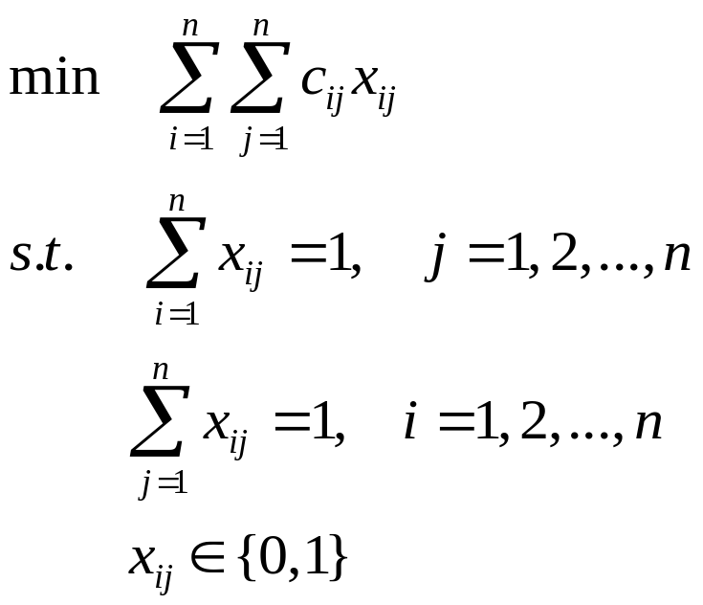
Model
Assignment problem gives a lower bound to the TSP.
(why?)

Slide 28
Assignment Problem
1
1
1
2
2
2
3
3
3
4
4
4
5
5
5

Slide 29
Assignment Problem
1
1
1
2
2
2
3
3
3
4
4
4
5
5
5

Slide 30
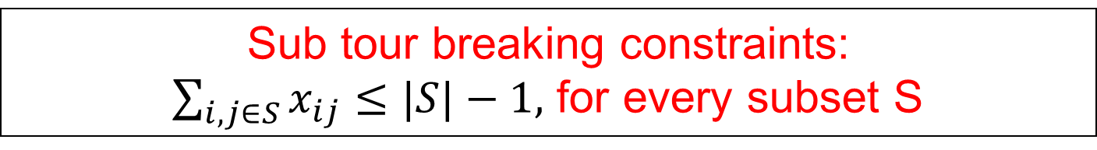
Model (Dantzig, Fulkerson & Johnson)
Sub tour breaking constraints:
$\sum_{i,j∈S}{x_{ij}}≤|S|−1,$ for every subset S

Slide 31
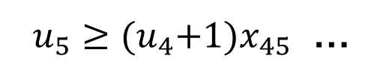

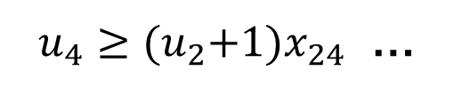

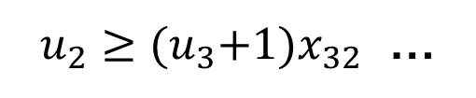

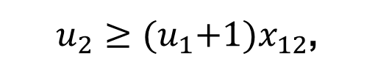


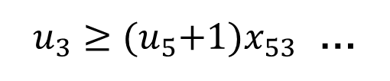
Counting Cities Traveled
$$u_{1}$$
$u_{2}≥{(u}_{1}+1)x_{12}$,
$u_{2}≥{(u}_{3}+1)x_{32}$ …
1
$u_{3}≥{(u}_{5}+1)x_{53}$ …
$$u_{2}$$
$$u_{3}$$
2
3
$u_{4}≥{(u}_{2}+1)x_{24}$ …
$u_{5}≥{(u}_{4}+1)x_{45}$ …
4
5
$$u_{4}$$
$$u_{5}$$

Slide 32


Counting Cities Traveled
$$u_{1}$$
1
$$u_{4}≥{(u}_{5}+1)x_{54}$$
$$u_{2}$$
$$u_{3}$$
2
3
$$u_{5}≥{(u}_{4}+1)x_{45}$$
4
5
$$u_{4}$$
$$u_{5}$$

Slide 33
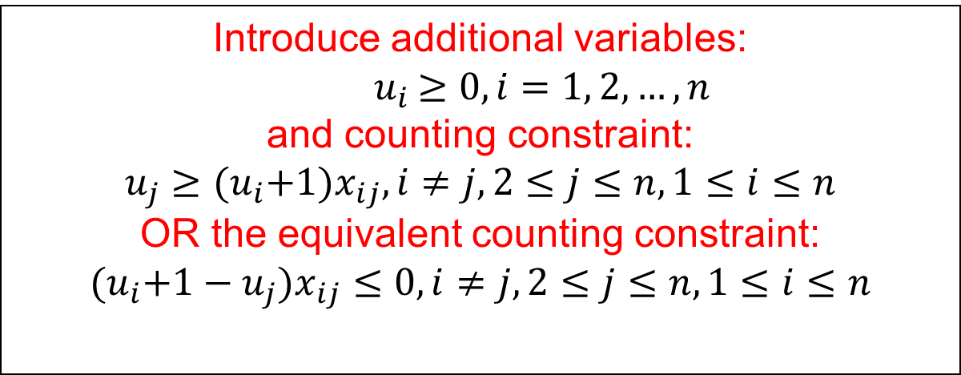
Model
Introduce additional variables:
$${ u}_{i} ≥0, i=1, 2,…,n$$
and counting constraint:
$$u_{j}≥{(u}_{i}+1)x_{ij}, i≠j, 2≤j≤n,1≤i≤n$$
OR the equivalent counting constraint:
$${(u}_{i}+1−u_{j})x_{ij}≤0, i≠j, 2≤j≤n,1≤i≤n$$

Slide 34
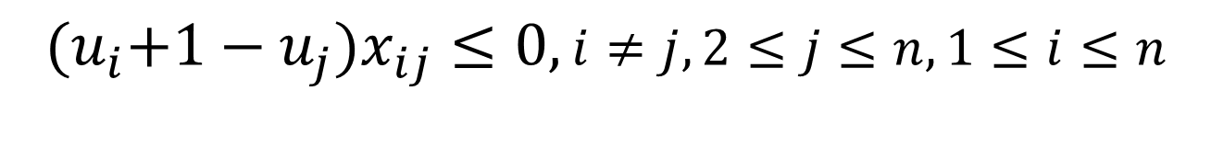
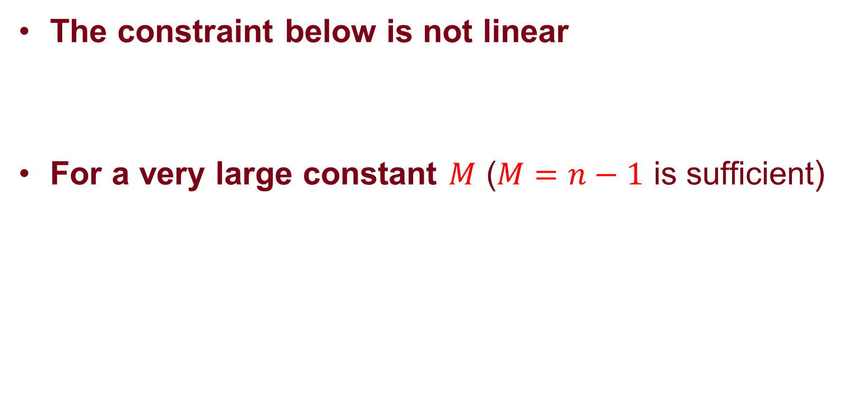
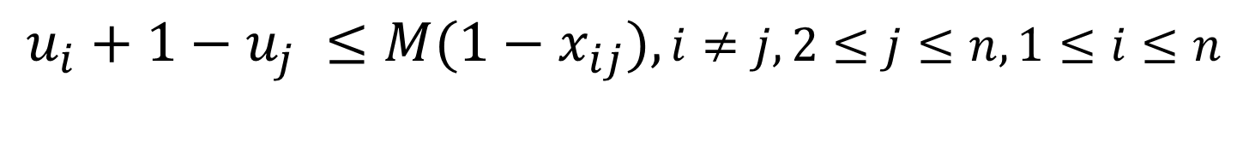
Transformation
The constraint below is not linear
For a very large constant $M$ ($M=n−1$ is sufficient)
$${(u}_{i}+1−u_{j})x_{ij}≤0, i≠j, 2≤j≤n,1≤i≤n$$
$$u_{i}+1−u_{j} ≤M(1−x_{ij}), i≠j, 2≤j≤n,1≤i≤n$$

Slide 35
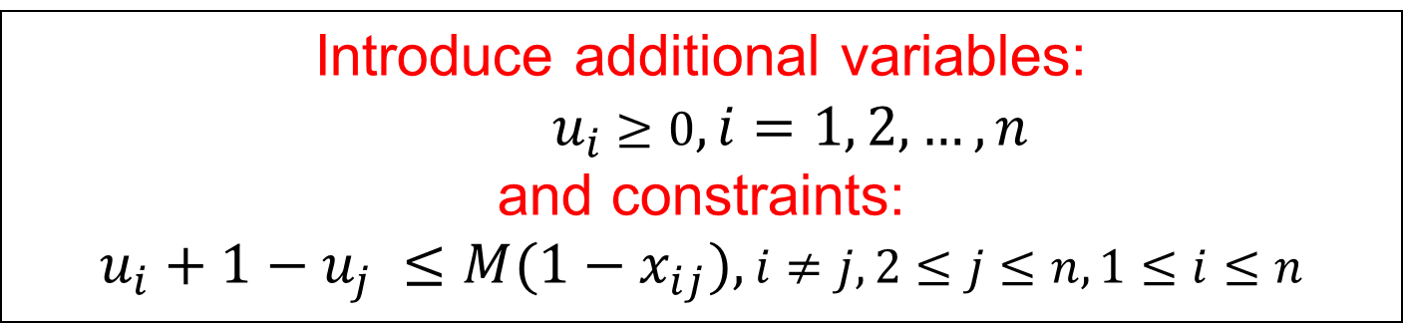
Model (Miller, Tucker and Zemlin)
Introduce additional variables:
$${ u}_{i} ≥0, i=1, 2,…,n$$
and constraints:
$$u_{i}+1−u_{j} ≤M(1−x_{ij}), i≠j, 2≤j≤n,1≤i≤n$$

Slide 36





Counting Accumulated Cost/Distance/Time
$$u_{1}$$
$$u_{2}≥{(u}_{1}+c_{12})x_{12}$$
$$u_{2}≥{(u}_{3}+c_{32})x_{32}$$
1
$$u_{4}≥{(u}_{2}+c_{24})x_{24}$$
$$u_{2}$$
$$u_{3}$$
$$u_{5}≥{(u}_{4}+c_{45})x_{45}$$
2
3
$$u_{3}≥{(u}_{5}+c_{53})x_{53}$$
4
5
$$u_{4}$$
$$u_{5}$$

Slide 37
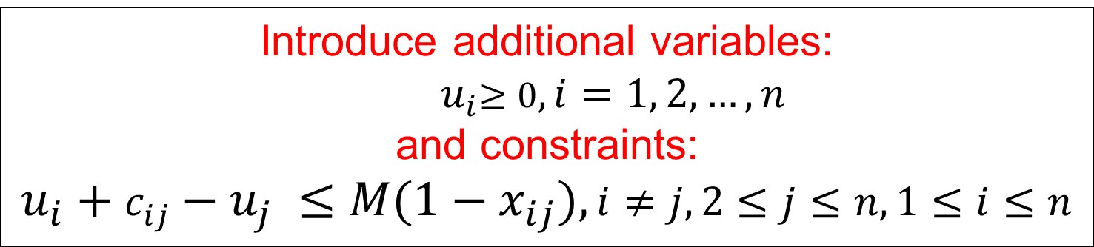
Model
Introduce additional variables:
$${ u}_{i}≥0, i=1, 2,…,n$$
and constraints:
$$u_{i}+c_{ij}−u_{j} ≤M(1−x_{ij}), i≠j, 2≤j≤n,1≤i≤n$$

Slide 38
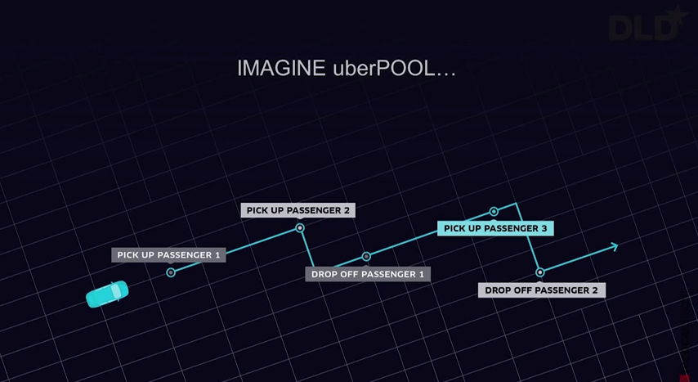
UberPOOL
Source: http://blog.under.com/uberPOOL-2015

Slide 39
An Example
Drop off passenger 3
7
1
Pick up passenger 2
3
Pick up passenger 3
4
1
6
1
1
Pick up passenger 1
Drop off passenger 2
Start point
Drop off passenger 1
2
2

Slide 40
The Problem
The objective is to find a route that achieves:
  Send every customer to his/her destination
  Minimizes the total time/distance traveled
Assumptions:
  We know every positions in advance
  The vehicle has unlimited capacity
How should we model the problem?

Slide 41
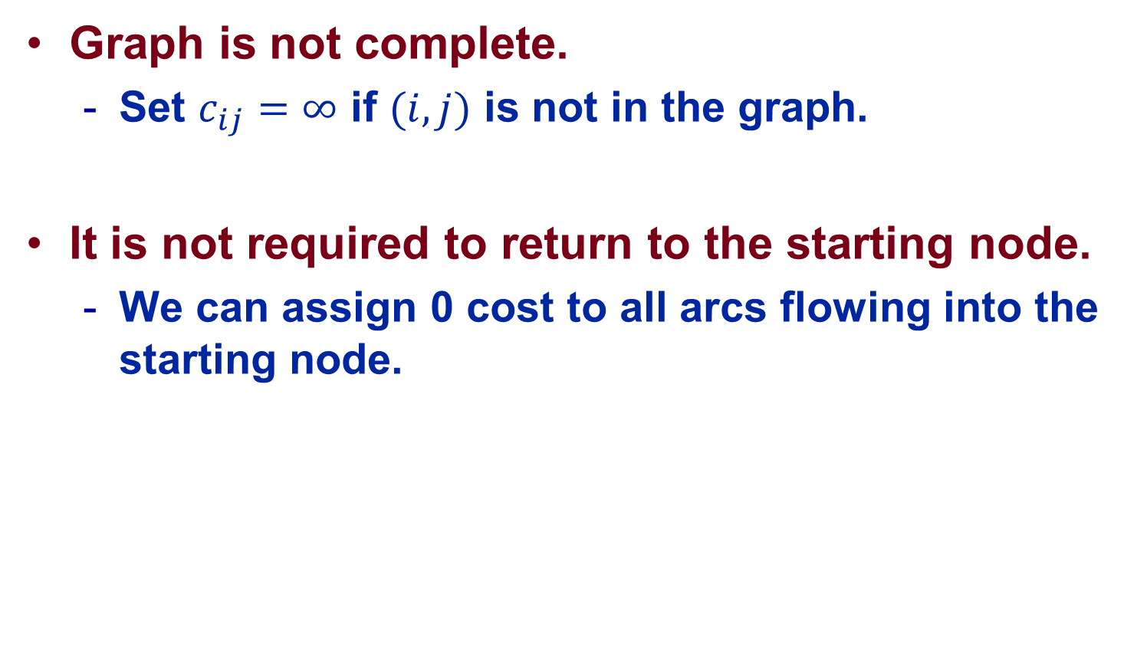
Model
Graph is not complete.
  Set $c_{ij}=∞$ if $(i,j)$ is not in the graph.
It is not required to return to the starting node.
  We can assign 0 cost to all arcs flowing into the starting node.

Slide 42
Modification
0
6
1000
7
1
2
3
5
4
1
6
1
1
1
4
Start point
3
2
2
0

Slide 43
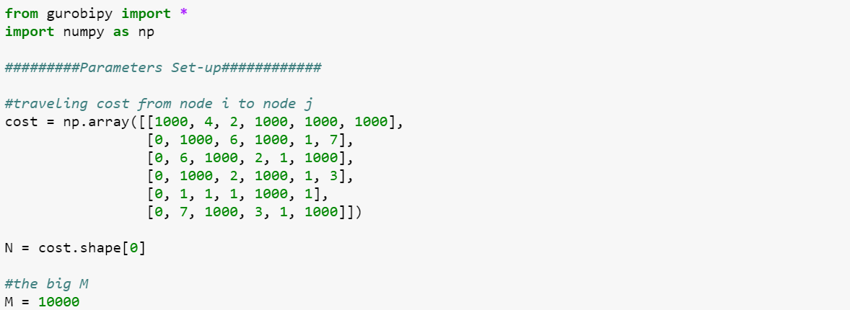
TSP: Data

Slide 44
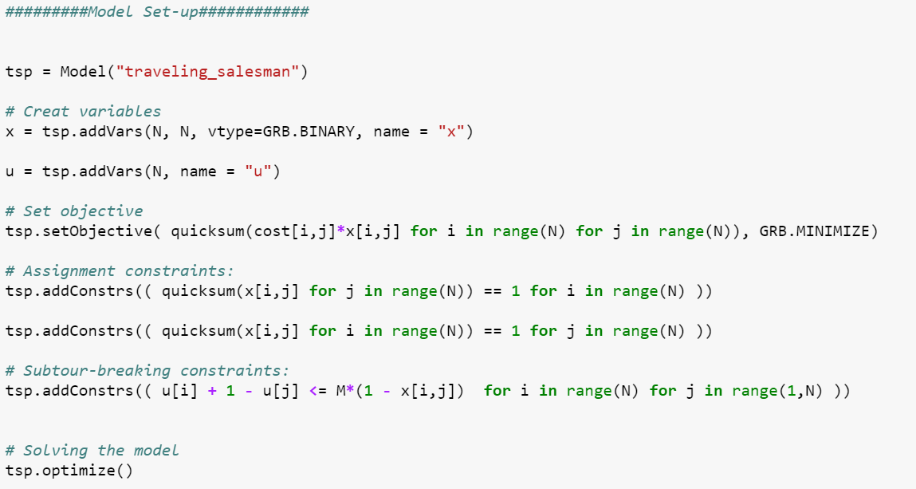
TSP: Model

Slide 45
Solution: Optimal Value 9
Is this solution feasible?
6. Drop off passenger 3
1
2. Pick up passenger 2
0
3
5. Pick up passenger 3
1
1. Pick up passenger 1
4. Drop off passenger 2
Start point
3. Drop off passenger 1
2
2

Slide 46
Precedence Constraints
In order to get a feasible solution, we need to impose precedence constraints:
  Node 1 (pick customer 1) need to be traveled before node 3 (drop customer 1) .
  Node 2 (pick customer 2) need to be traveled before node 4 (drop customer 2) .
  Node 5 (pick customer 3) need to be traveled before node 6 (drop customer 3) .

Slide 47

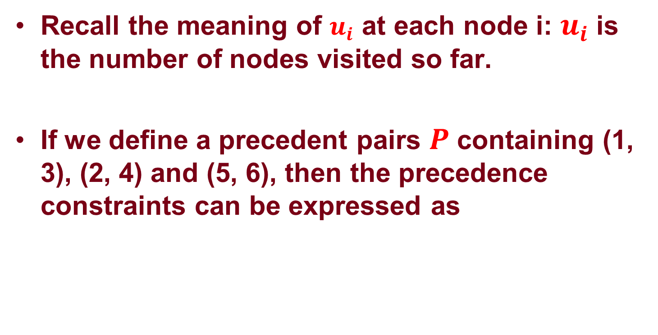
Precedence Constraints
Recall the meaning of $u_{i}$ at each node i: $u_{i}$ is the number of nodes visited so far.
If we define a precedent pairs $P$ containing (1, 3), (2, 4) and (5, 6), then the precedence constraints can be expressed as
$$u_{i}≤u_{j}, for (i,j)∈P$$

Slide 48
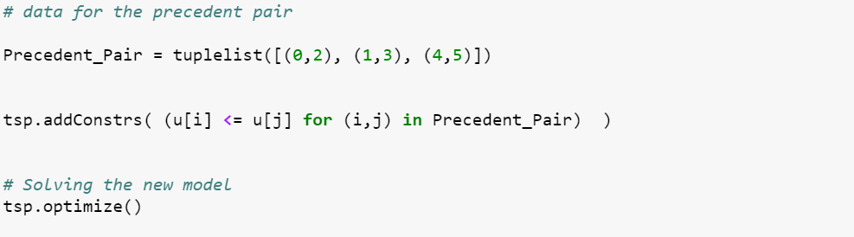
Precedence Constraints

Slide 49
Solution: Optimal Value 11
0
6. Drop off passenger 3
2. Pick up passenger 2
5. Pick up passenger 3
3
4
1
1
1. Pick up passenger 1
4. Drop off passenger 2
Start point
3. Drop off passenger 1
2

Slide 50
OR Solution: Optimal Value 11
6. Drop off passenger 3
1
2. Pick up passenger 2
3
5. Pick up passenger 3
4
1
1. Pick up passenger 1
4. Drop off passenger 2
Start point
3. Drop off passenger 1
0
2

Slide 51
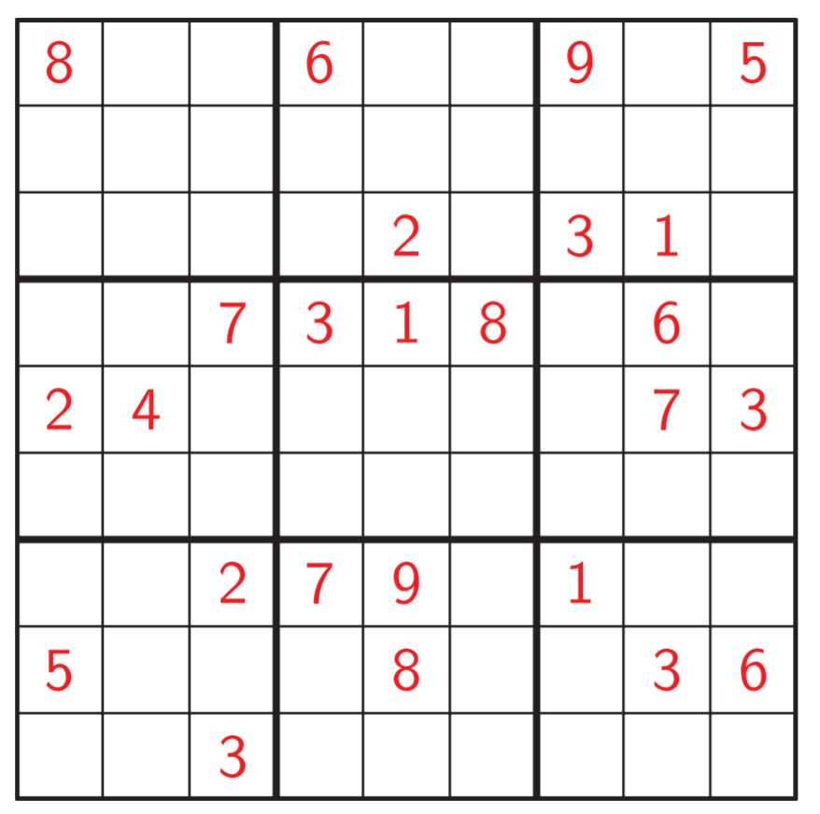
Sudoku

Slide 52
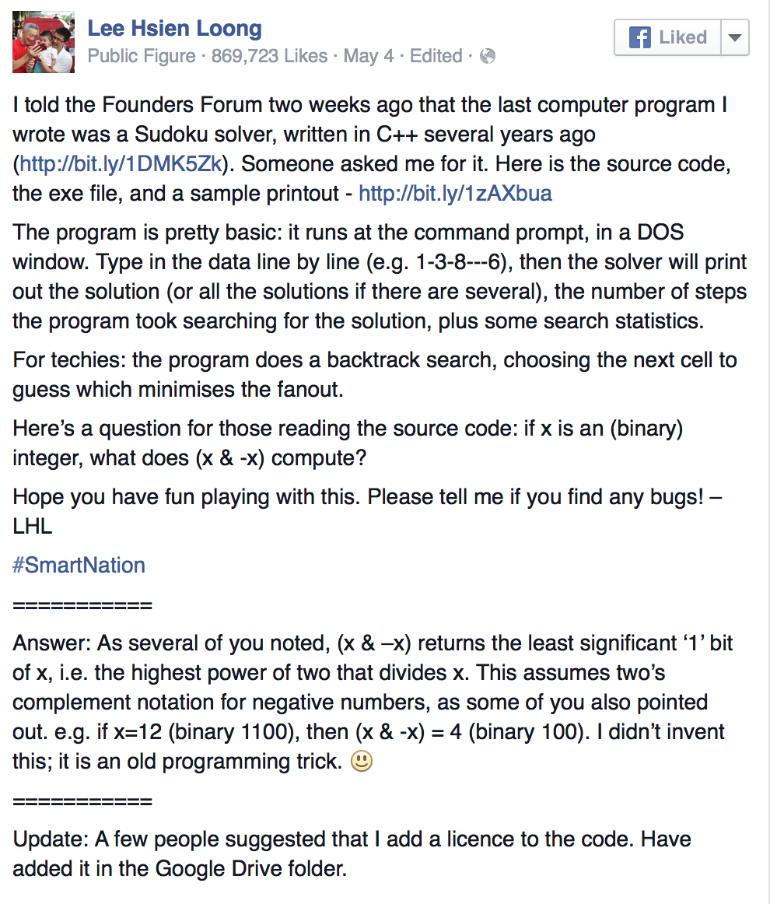
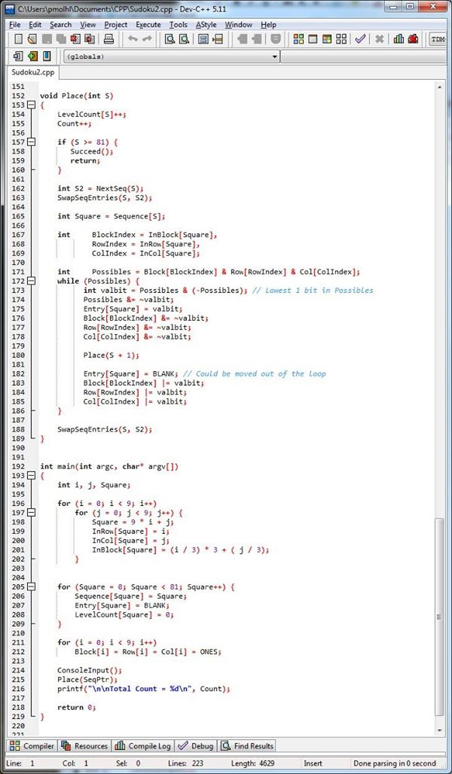
Sudoku

Slide 53
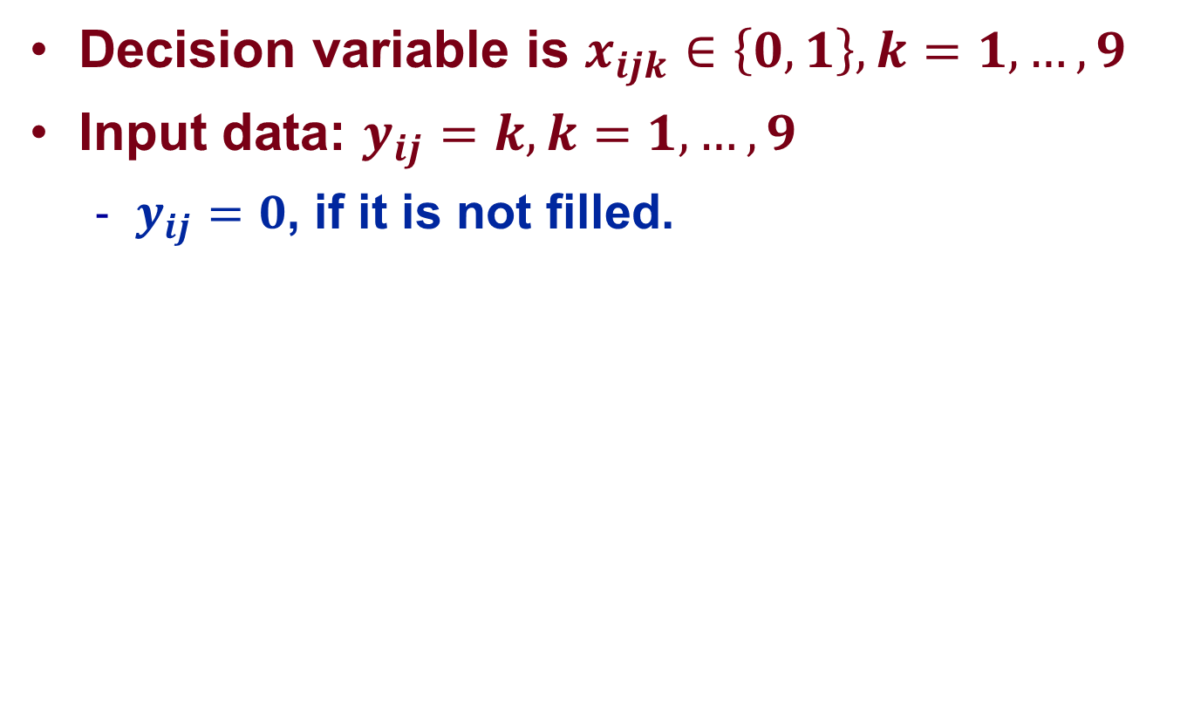
Sudoku: IP Formulation
Decision variable is $x_{ijk}∈\left\{0, 1\right\}, k=1,…,9$
Input data: $y_{ij}=k, k=1,…,9$
  $y_{ij}=0$, if it is not filled.

Slide 54
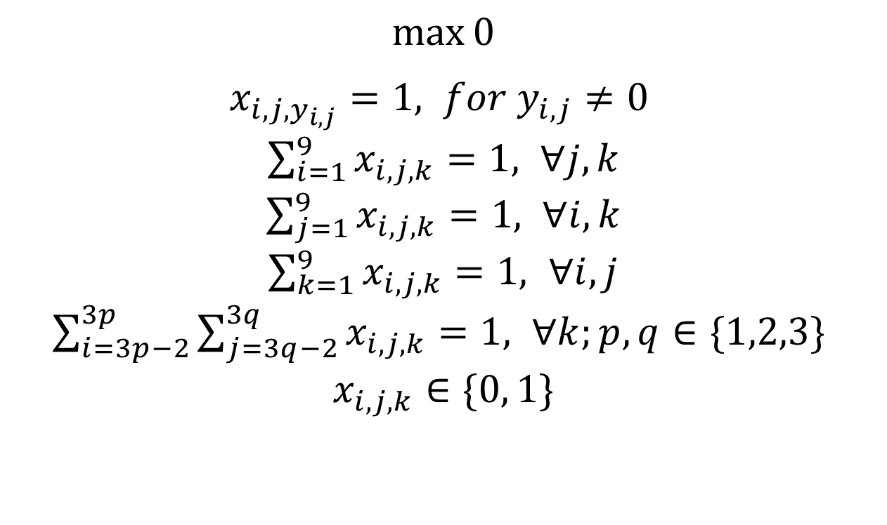
Sudoku: IP Formulation
$\max_{}{0}$
$x_{i,j,y_{i,j}}=1, for y_{i,j}≠0$
$\sum_{i=1}^{9}{x_{i,j,k}}=1, ∀j,k$
$\sum_{j=1}^{9}{x_{i,j,k}}=1, ∀i,k$
$\sum_{k=1}^{9}{x_{i,j,k}}=1, ∀i,j$
$\sum_{i=3p−2}^{3p}{\sum_{j=3q−2}^{3q}{x_{i,j,k}}}=1, ∀k;p,q∈\{1,2,3\}$
$$x_{i,j,k}∈\{0, 1\}$$

Slide 55
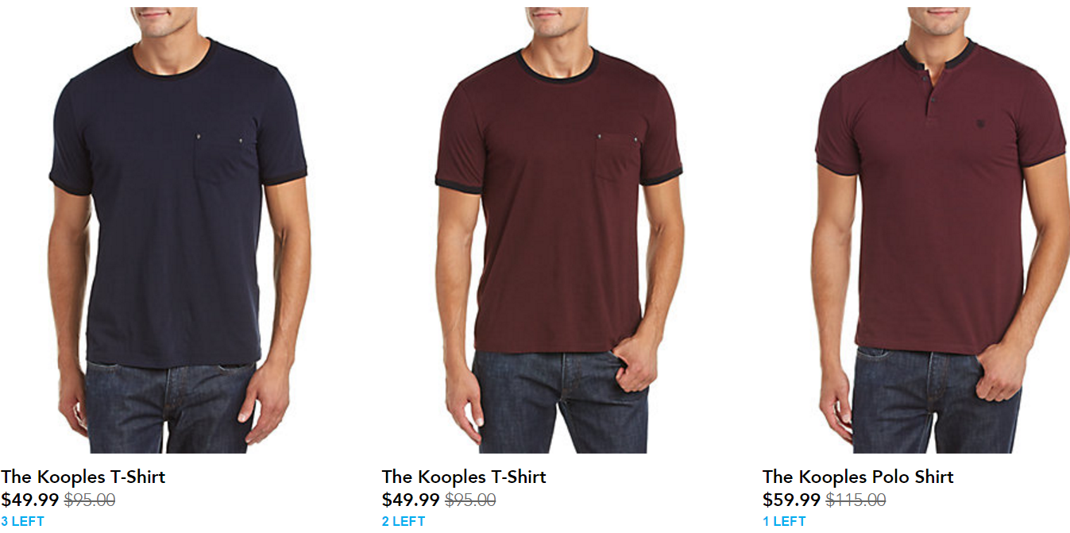
Rue La La
Source: https://www.ruelala.com/boutique/
1
2
3
Price Grids
$39.99
$44.99
$49.99
$54.99
$59.99
$39.99
$44.99
$49.99
$54.99
$59.99
$39.99
$44.99
$49.99
$54.99
$59.99

Slide 56
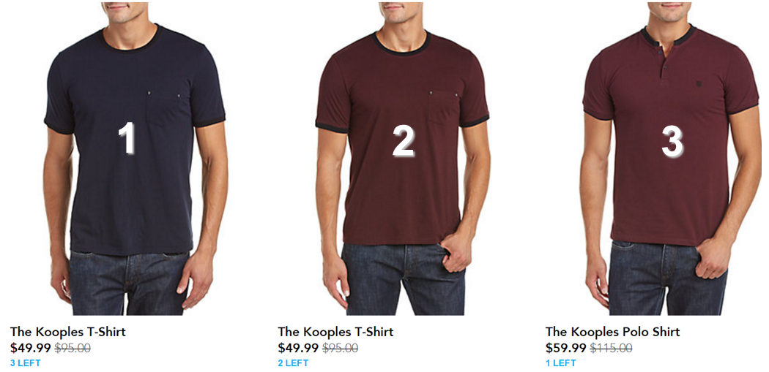

What do we need?
$39.99
What are the demands for products 1, 2 and 3 under prices ($49.99, $49.99, $59.99)?
Will demand for product 1, 2 and 3 change under prices ($49.99, $39.99, $59.99)?
How many possible price points are there?
$5^{3} (M^{N})$

Slide 57
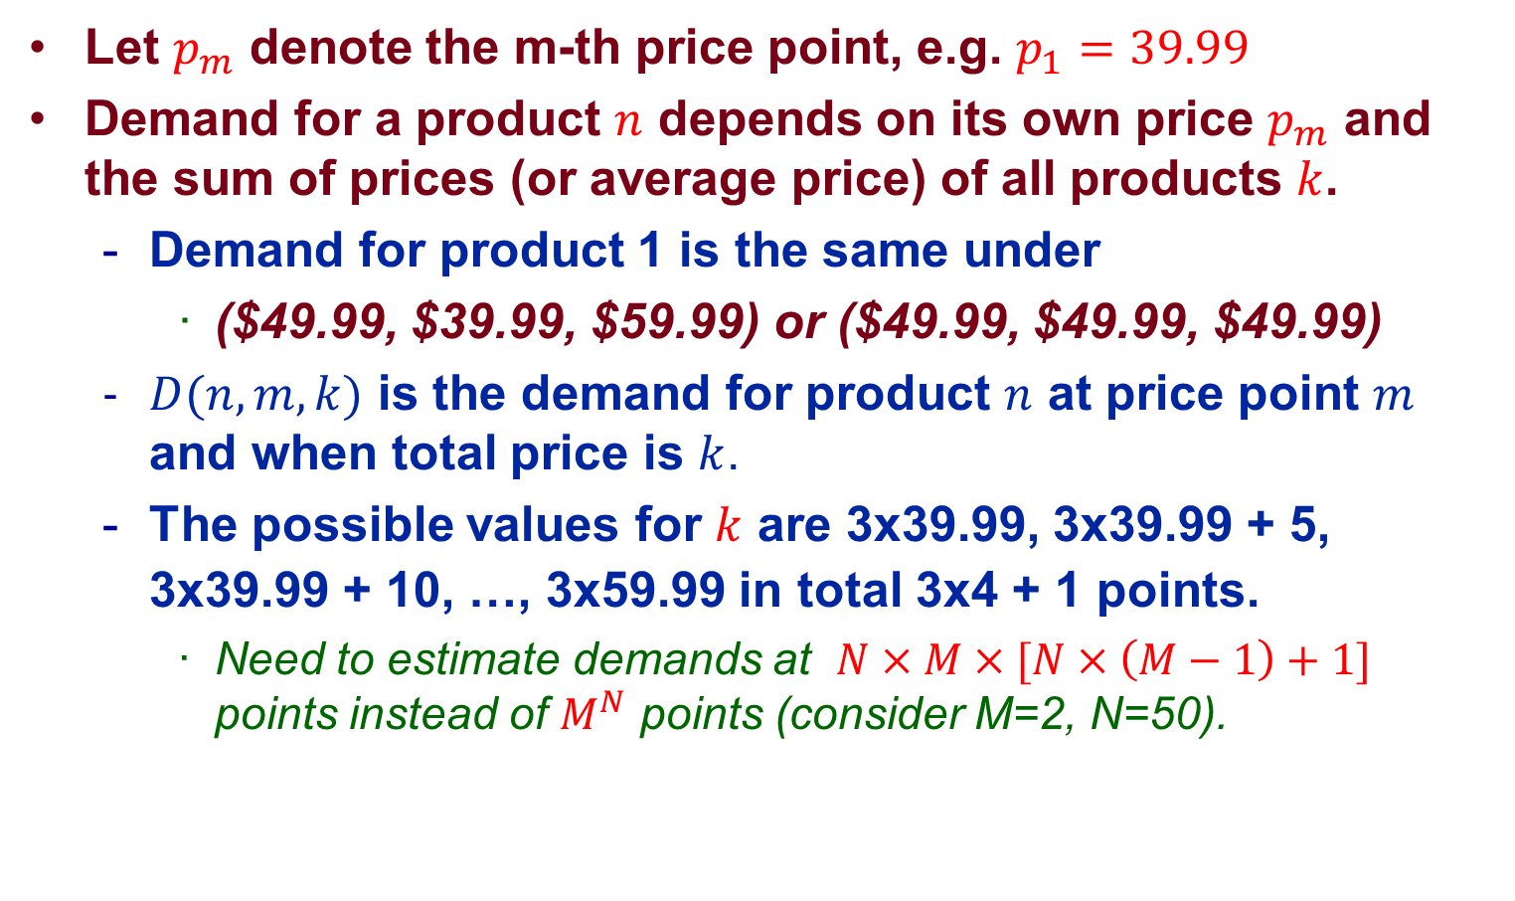
Simplification Assumption
Let $p_{m}$ denote the m-th price point, e.g. $p_{1}=39.99$
Demand for a product $n$ depends on its own price $p_{m}$ and the sum of prices (or average price) of all products $k$.
  Demand for product 1 is the same under
    ($49.99, $39.99, $59.99) or ($49.99, $49.99, $49.99)
  $D(n,m, k)$ is the demand for product $n$ at price point $m$ and when total price is $k$.
  The possible values for $k$ are 3x39.99, 3x39.99 + 5, 3x39.99 + 10, …, 3x59.99 in total 3x4 + 1 points.
    Need to estimate demands at $N×M×[N×\left(M−1\right)+1]$ points instead of $M^{N}$ points (consider M=2, N=50).

Slide 58

Optimization Model
Here, $D(n,m, k)$is not a parameter, since $k$ depends on the prices of each of the product.
If $k$ is fixed, say, $k=3×49.99$, can we model the problem?
  $x_{n,m}=1$ if product $n$ is priced at price point $p_{m}$, $x_{n,m}=0$ otherwise.
  Objective: ${z_{k}=max{\sum_{n=1}^{N}{\sum_{m=1}^{M}{p_{m}D(n,m,k)}}}x}_{n,m}$
  Choose only one price: $\sum_{m=1}^{M}{x_{n,m}=1}$
  Total price is $k$: $\sum_{n=1}^{N}{\sum_{m=1}^{M}{p_{m}x_{n,m}}}=k$

Slide 59

Optimization Model
But $k$ is not fixed…
  Try every possible $k$ !
  For $k$ = 3x39.99, 3x39.99 + 5, …, 3x59.99
  Solve the IP to obtain $z_{k}$
  Find the maximum $z_{k}$.

Slide 60
Job Shop Scheduling
A clinic is determining the service schedules for the following patients in the next day.
Waiting is possibly inevitable: e.g.,
  Patient A: imaging from 8-10, OT from 10-13, recovery from 13-15
  Patient C: wait 2 hours for imaging and wait another 2 hours for OT.
Objective: Minimize total waiting time = total completion time
Patient | Step 1 | Step 2 | Step 3
A | Imaging Center, 2h | Operating Theatre, 3h | Recovery Room, 2h
B | Operating Theatre, 2h | Recovery Room, 3h | Imaging Center, 1h
C | Imaging Center, 1h | Operating Theatre, 2h | Recovery Room, 3h

Slide 61

General Description
$N=\{1,2,…,n\}$ be the set of jobs, e.g., a list of patients. $M=\{1,2,…,m\}$ be the set of machines, e.g., facilities.
For each job $i∈N$
  $M_{i}⊆M$: set of machines required by job $i$.
  $p_{ik}$: processing time of job $i$ on machine $k$.
  $P_{i}$: precedence pairs, $\left(k,l\right)∈P_{i}$ means job $i$ must finish on machine $k$ before starting on machine $l$.
In our example:
  $M_{A}=\{IC, OT, RR\}$ and $P_{A}=\{\left(IC,OT\right),(OT,RR)\}$
  $p_{A,IC}=2,p_{A,OT}=3,p_{A,RR}=2$

Slide 62

Model
$s_{i,k}$ be the starting time of job $i$ on machine $k∈M_{i}$, and $s_{i,Finish}$ be the completion time job $i$.
Objective: $min\sum_{i=1}^{n}{s_{i,Finish}}$
Within-job precedence constraint: for job $i$
  $s_{i, l}≥s_{i,k}+p_{i,k}, ∀\left(k,l\right)∈P_{i}$
  $s_{i, Finish}≥s_{i,k}+p_{i,k}, ∀k∈M_{i}$
Within-machine precedence constraint: for machine $k$ and jobs $i,j$ such that $k∈M_{i}∩M_{j}$
  $s_{j, k}≥s_{i,k}+p_{i,k}$OR $s_{i, k}≥s_{j,k}+p_{j,k}.$

Slide 63
Linear Programming Relaxation

Slide 64




Method of LP Relaxation
Minimize: $c^{′}x$
s.t. $Ax=b$
$x≥0,$integer
Minimize: $c^{′}x$
s.t. $Ax=b$
$x≥0,$binary
LP Relaxation
Minimize: $c^{′}x$
s.t. $Ax=b$
$x≥0$
Minimize: $c^{′}x$
s.t. $Ax=b$
$0≤x≤1$
Round the solution to the nearest integers

Slide 65
Investment Example
Consider two investments opportunities:
  Invest $100K, return 1 million 40 years later.
    Annual rate of return: 5.9%
  Invest $80K, return 0.95 million 40 years later.
    Annual rate of return: 6.4%
Budget constraint: $100K.
Objective: Maximize the return after 40 years.

Slide 66




Model
IP formulation:
LP relaxation
Maximize: ${1000x}_{1}+{950x}_{2}$
s.t. ${100x}_{1}+{80x}_{2}≤100$
$x_{1},x_{2}$ binary
Maximize:${1000x}_{1}+{950x}_{2}$
s.t. ${100x}_{1}+{80x}_{2}≤100$
$${0≤x}_{1},x_{2}≤1$$
$${(x}_{1},x_{2})=(0.2, 1)$$
$${(x}_{1},x_{2})=(0, 1)$$

Slide 67
Method of LP Relaxation
Minimize: $c^{′}x$
s.t. $Ax=b$
$x≥0,$integer
Minimize: $c^{′}x$
s.t. $Ax=b$
$x≥0,$binary
LP Relaxation
Minimize: $c^{′}x$
s.t. $Ax=b$
$x≥0$
Minimize: $c^{′}x$
s.t. $Ax=b$
$0≤x≤1$
When are they the same?

Slide 68


Cramer’s Rule
The solution for LP: $Bx_{B}=b$
Cramer’s Rule: consider a system of n linear equations and n unknowns
$$Bx=b$$
$$x_{i}=\frac{det(M_{i})}{det(B)}$$
$$M_{i}=[B_{1},…,B_{i−1},b,B_{i+1},…,B_{n}]$$

Slide 69
Totally Unimodular Matrix
Unimodular Matrix: A square integer matrix having determinant +1 or -1.
If the optimal basis is unimodular, then we are done.
Totally Unimodular Matrix: A matrix for which every square non-singular submatrix is unimodular.
If $A$ is totally unimodular, then we are done.

Slide 70

Necessary Condition and Example
Every entry of $A$ is 0, +1, or -1

Slide 71
Branch and Bound Method

Slide 72


Knapsack Problem
How many feasible solutions do we have?
  Consider $n=50$
NP-hard
Maximize: $\sum_{i=1}^{n}{p_{i}x_{i}}$
s.t. $\sum_{i=1}^{n}{c_{i}x_{i}}≤b$
$x_{i}$ binary

Slide 73

Investment Example
Consider three investments opportunities:
  Invest $100K, return 1 million 40 years later.
    Annual rate of return: 5.9%
  Invest $80K, return 0.95 million 40 years later.
    Annual rate of return: 6.4%
  Invest $50K, return 0.35 million 40 years later.
    Annual rate of return: 5.0%
Budget constraint: $200K.
Objective: Maximize $z$: the return after 40 years.

Slide 74



How to Branch
LP relaxation
Branch: consider two sub-problems:
  $x_{3}=0$
  $x_{3}=1$
Maximize:${1000x}_{1}+{950x}_{2}+{350x}_{3}$
s.t. ${100x}_{1}+{80x}_{2}{+50x}_{3}≤200$
$${0≤x}_{1},x_{2},x_{3}≤1$$
${(x}_{1},x_{2},x_{3})=\left(1, 1, 0.4\right);$ Objective: 2090

Slide 75



How to Bound
First branch: $x_{3}=0$
What information do we get from this?
  $z≥1950$
  $z≤2090$ (from the full problem)
Maximize:${1000x}_{1}+{950x}_{2}+{350x}_{3}$
s.t. ${100x}_{1}+{80x}_{2}{+50x}_{3}≤200$
$${0≤x}_{1},x_{2}≤1,x_{3}=0$$
${(x}_{1},x_{2},x_{3})=\left(1, 1, 0\right);$ Objective: 1950

Slide 76



How to Bound
Second branch: $x_{3}=1$
What information do we get from this?
  $1950≤z≤2000$
  Need to further branch: maybe a better solution than (1, 1, 0) lies in this branch.
Maximize:${1000x}_{1}+{950x}_{2}+{350x}_{3}$
s.t. ${100x}_{1}+{80x}_{2}{+50x}_{3}≤200$
$${0≤x}_{1},x_{2}≤1,x_{3}=1$$
${(x}_{1},x_{2},x_{3})=\left(0.7, 1, 1\right);$ Objective: 2000

Slide 77




Branches in Branch $x_{3}=1$
First branch: $x_{1}=0$
What information do we get from this?
  Since $1950≤z≤2000$, this branch cannot contain optimal solution, no need to explore further.
Maximize:${1000x}_{1}+{950x}_{2}+{350x}_{3}$
s.t. ${100x}_{1}+{80x}_{2}{+50x}_{3}≤200$
$$0≤x_{2}≤1,x_{1}=0,x_{3}=1$$
${(x}_{1},x_{2},x_{3})=\left(0, 1, 1\right);$ Objective: 1300

Slide 78



Branches in Branch $x_{3}=1$
Second branch: $x_{1}=1$
What information do we get from this?
  Since $1950≤z≤2000$, this branch cannot contain optimal solution, no need to explore further.
Maximize:${1000x}_{1}+{950x}_{2}+{350x}_{3}$
s.t. ${100x}_{1}+{80x}_{2}{+50x}_{3}≤200$
$$0≤x_{2}≤1,x_{1}=1,x_{3}=1$$
${(x}_{1},x_{2},x_{3})=\left(1, 0.625, 1\right);$ Objective: 1943.75

Slide 79









Tree View
${(x}_{1},x_{2},x_{3})=\left(1, 1, 0.4\right);$ Objective: 2090
$$x_{3}=0$$
$$x_{3}=1$$
${(x}_{1},x_{2},x_{3})=\left(1, 1, 0\right);$ Objective: 1950
${(x}_{1},x_{2},x_{3})=\left(0.7, 1, 1\right);$ Objective: 2000
$$x_{1}=0$$
$$x_{1}=1$$
${(x}_{1},x_{2},x_{3})=\left(0, 1, 1\right);$ Objective: 1300
${(x}_{1},x_{2},x_{3})=\left(1, 0.625, 1\right);$ Objective: 1943.75

